Slide 1

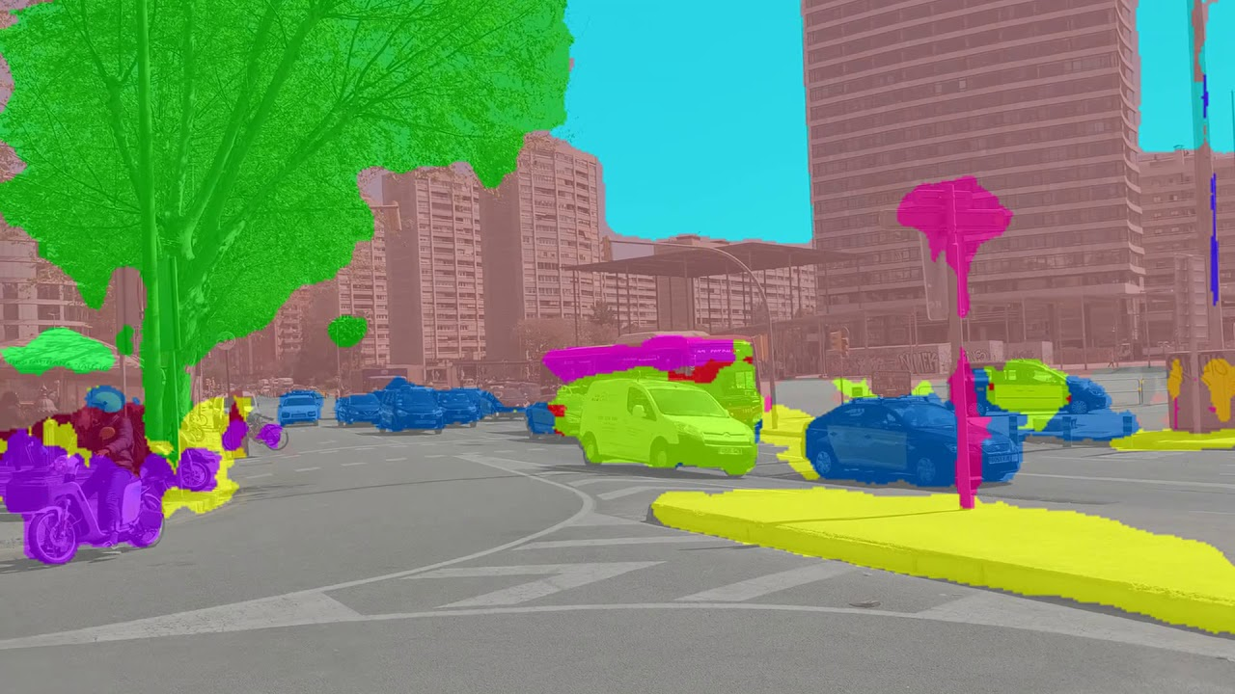
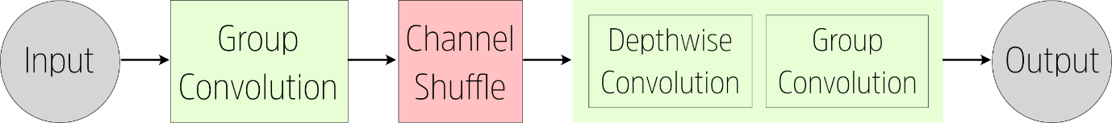
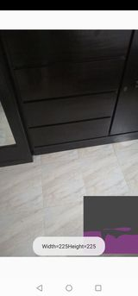
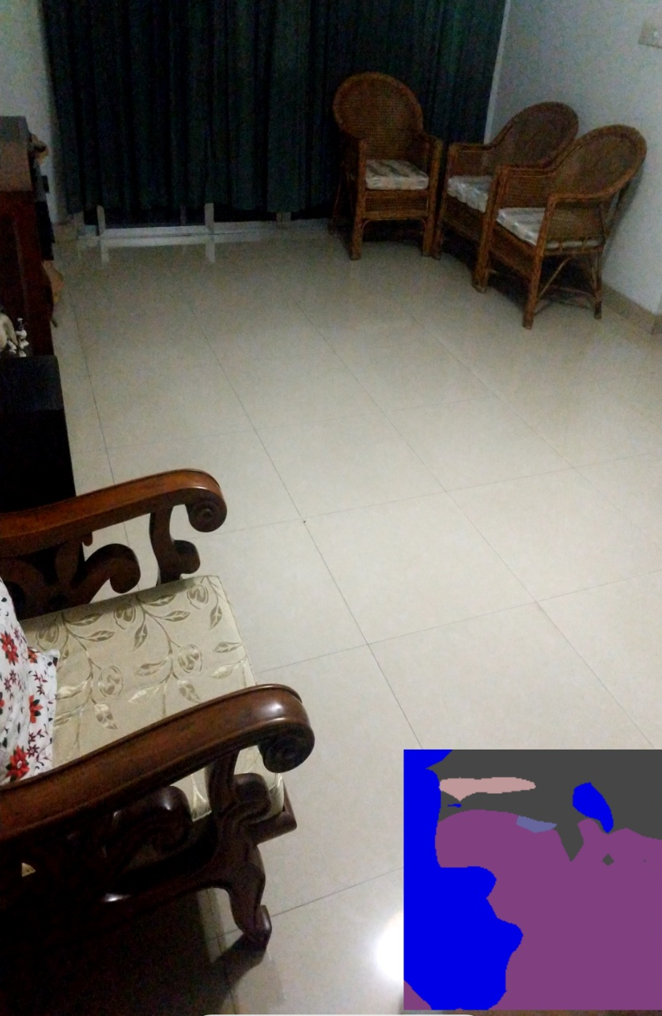
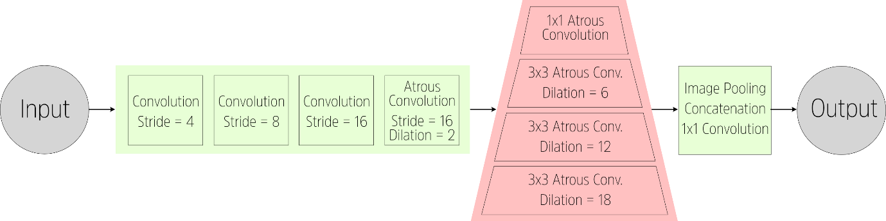
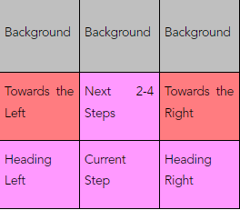
Navigational Assistance for the Visually
Impaired Using Computer Vision
Shadab Hafiz Choudhury, Ishrat Jahan Ananya, Sarah Suad, Nabiul Hoque Khandakar
Department of Computer Science and Engineering, North South University
Abstract
Methodology and App Design
Dataset
Conclusion
Blind people face many difficulties in daily life, one of which is navigation. There are several solutions leveraging the use of computer hardware and artificial intelligence to help guide them. However, most current solutions use complicated hardware and so are not suitable for everyone. This project uses deep learning to implement a semantic segmentation algorithm that recognizes walkable areas in an interior environment in real-time, directing users away from obstacles such as furniture or people.
We test ShuffleNet and DeepLabv3 and implement the former into an app that can be used on any android phone. The app is capable of recognizing obstacles within two steps of the user and warning them accordingly.
The mobile phone is mounted at the user’s shoulder and aimed at a slight angle downwards. This can be done using a simple system of straps and holsters. Or the user can hold it up with one hand. From this viewpoint, the bottom third of the image frame will cover the area immediately in front of the user’s feet.
The camera is activated and continuously streams a preview of the area in front. Every second, (this rate is changeable), the current frame is converted to a bitmap image and sent to the segmentation algorithm. The segmenter gives a segmented output image, based on which the app tells the user to keep walking or stop because there is an obstacle.
The primary dataset to use in this project is the MIT ADE20k Dataset for Scene Segmentation. This dataset features 20,120 images taken from a wide variety of scenes both outdoors and indoors.
The ADE20k Dataset features a total of 150 Classes. However, most of these classes are either superfluous, or too finely detailed, for the task at hand. Therefore, the class labels were consolidated into a number of classes that were more relevant:
1 (Wall) <~~~~~~ 9 (window), 15 (door), 33 (fence), 43 (pillar), 44 (sign board), 145 (bulletin board)
4 (Floor) <~~~~~~ 7 (road), 14 (ground, 30 (field), 53 (path),55 (runway))
8 (Furniture) <~~~ 8 (bed), 11 (cabinet), 14 (sofa), 16 (table), 19 (curtain), 20 (chair), 25 (shelf), 34 (desk)
7 (Stairs) <~~~~~~ 54 (stairs)
26 (Others) <~~~~ 18 (plant), class numbers larger than 26
Using Deep Learning, interior surfaces can be efficiently and accurately deciphered in a format suitable for the computer. As such, it can be used to develop an extremely cost-effective solution for helping blind people navigate in an environment full of obstacles, such as interior spaces. As the system is in real-time and implements a ‘Free Space Detection’ approach, any sudden changes in the environment such as a person walking in front will also be detected by the system. Therefore, this research proposes that a semantic segmentation model is developed using one of the mentioned architectures and datasets, and integrated into a mobile app that will handle the inputs and outputs. Such an app would be quite useful to the visually impaired.
In regards to future work, we can concentrate on 1) developing a more efficient semantic segmentation architecture with an enhanced inference pipeline, 2) adding features such as the app describing the contents of a room to the user based on what objects have been segmented within each grid location, 3) building up a more tailored dataset with annotated images taken from the perspective of visually impaired people, 3) providing more intuitive feedback to the user via haptic interfaces, spatial sound etc.
A long-term priority will be to increase the speed & accuracy of the inference process on our proposed system. The simplest way to accomplish this is to delve into implementing better state-of-the-art neural network models that are capable of delivering more accurate inferences on a wider range of inputs. The usage of these such neural networks though comes with a cost of taking up more space on the user’s smartphone. These big multi-layered networks can often take up to 500 Megabytes on the user’s smartphone, which is something that we cannot afford if we are trying to put out our solution on a mobile device.
As a resolution to this problem, we can set up the smartphone’s camera to stream data to a server running our algorithms. This server will include Graphics Processing Units (GPU’s) to further boost the time and accuracy of our inferences and increase the frame rate of our system while freeing up CPU cycles on the smartphone for other processes. This would allow the app to have two modes: a less accurate but usable offline mode and a powerful, developed ‘online’ mode.
Furthermore, we could exercise a collaborative effort to develop a standard benchmark dataset for this and develop a more tactile interface to give audio feedback to the user.
Semantic Segmentation
One of the most common applications of computer vision and deep learning is image segmentation. Image segmentation is simply the process of breaking down a normal image into different components that can be efficiently analysed by a computer. Below we discuss two models chosen for the task.
Shufflenet
Shufflenet is a CNN architecture that was developed from the idea of MobileNet, aiming to be extremely efficient using limited computing resources. In ShuffleNet, group convolutions are utilized. In grouped convolutions, filters are separated into several different groups. Each group applies filters in a parallel manner, and at the end the final output layer is composed by combining the outputs of each group. Grouped convolutions were first proposed in AlexNet and have been further developed since then.
Introduction
Visually impaired people face many difficulties in daily life. As they are bereft of visual stimulus, they cannot interact or navigate the world around them easily. Locating and picking up an object is a difficult task. It is hard for them to navigate through a room full of furniture or other obstacles, as their perception is limited to the length of a walking stick.
There are currently 285 Million people around the world with varying levels of visual impairment. In Bangladesh, 6 million people exhibit some form of visual impairment, ranging from mild to severe.
One of the major pitfalls of hardware-based solutions is that hardware is expensive to manufacture, import and maintain. In a developing country like Bangladesh, the majority of the 750 thousand blind people are underprivileged and will not be able to bear those expenses easily. Software-based solutions have the advantage in that there’s no cost to downloading new copies of it.
The goal of this research is to use purely computer vision to help a blind person gain knowledge of obstacles in front of them so they can navigate around. This would be a significant step in making moving around easier for them. Below is a demo of the project.
DeepLabV3
Developed by Google, DeepLabV3 is one of the most accurate and powerful architectures for semantic segmentation available today. The DeepLabv3 archtecture makes use of Atrous Convolutions (also called dilated convolutions). In an Atrous convolution, holes are placed between each unit or pixel of the filter. So, each convolution will cover a wider area, but the filter size will remain the same.
Results
The final output is generated based on the grid where The presence of free walking space or clutter is determined by the colour of the segmented image in that particular section of the grid.
The current app has implemented a ShuffleNet v2 model due to issues with the DeepLab v3 model, even though the latter model would have been more accurate.
If purple is used to denote the floor in the segmented image, then the function will check for the prevalence of purple in the ‘Current Step’ position of the grid. This current step is the most important position in our grid, since it is where the user will step next. If another object appears in the ‘Current Step’ position, then the segmented output will return a different colour. The function will send a call to the text-to-speech function to tell the user “Obstacle in front!” This message will have the highest priority.
Additional warnings can also be built in in a similar way. If an obstacle is detected in ‘Heading Left’ or ‘Heading Right’, the system can tell the user “Obstacle to left/right!” If an obstacle is detected in the “Next 2-4 Steps”, the system will tell the user “Obstacle up ahead.”
Overall, the expectation is that the user will be aware of obstacles nearby, and stop as necessary when they get too close.
Audio Output Generation
Once a segmented image has been received, the final task is to generate an audio output.
The output segmented image will be divided into a grid of 9 parts. The most important part is where their next few steps will be. If the ‘Current Step’ is not purple (i.e. not clear floor), then the user will be stopped.
Acknowledgements
We are extremely grateful to all the Faculty and Staff of Electrical and Computer Engineering Department for providing us with the opportunity and platform.
Specially, we would also specially like to acknowledge and thank our supervisor, Tanjila Farah, Senior Lecturer of the Department of Electrical and Computer Engineering of North South University. We are indebted to her for her efforts, providing guidance and advice over the course of our senior design project.

